Slide 1
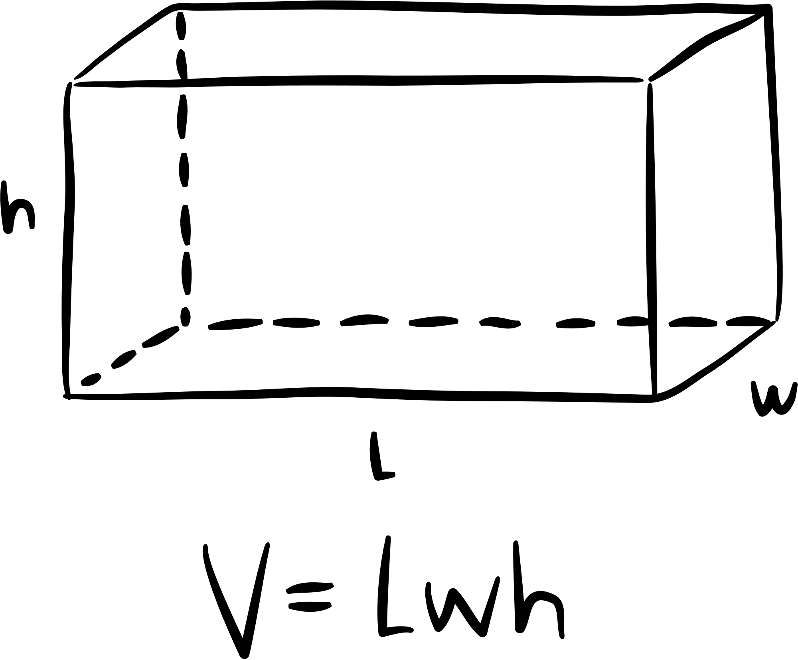
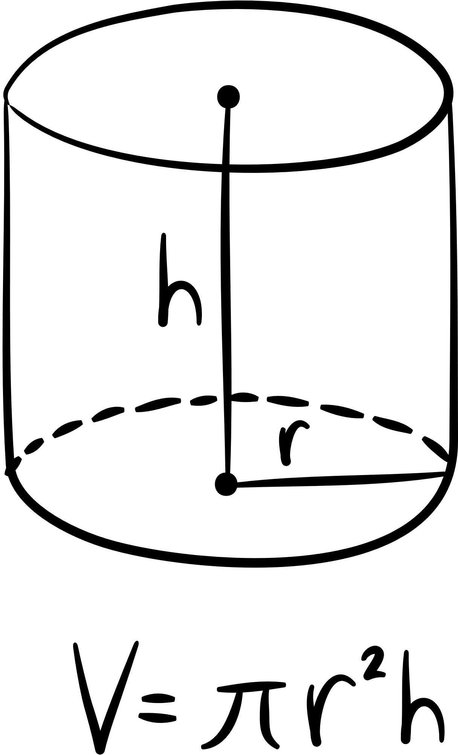
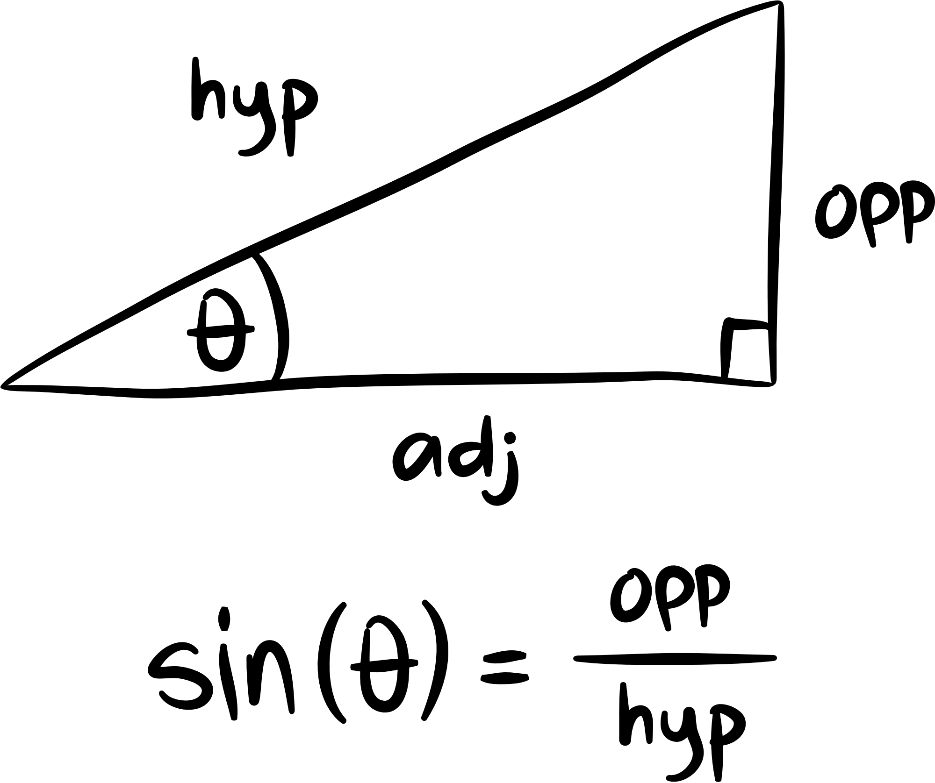
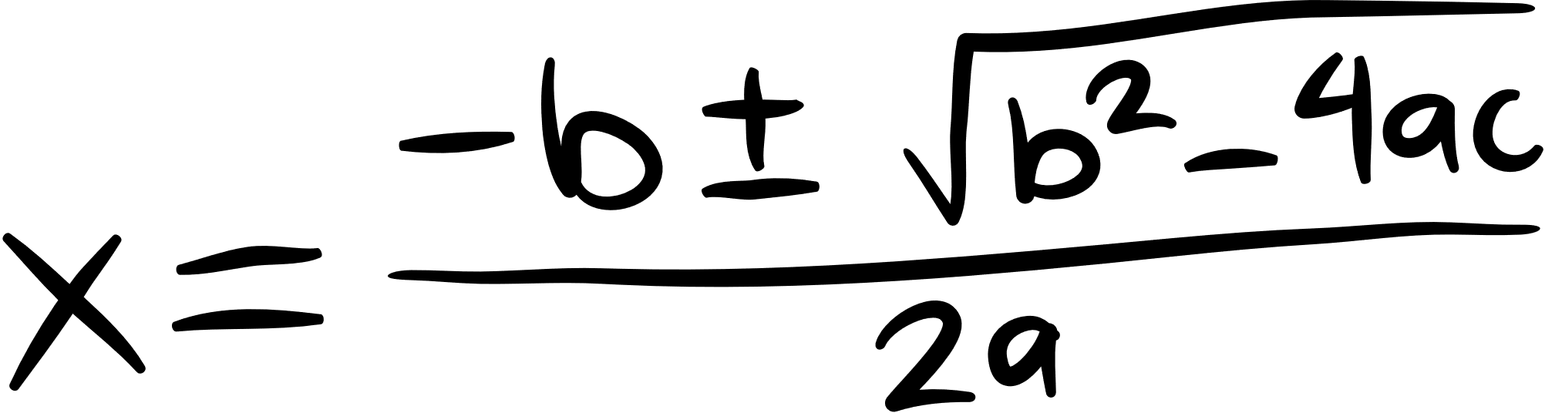
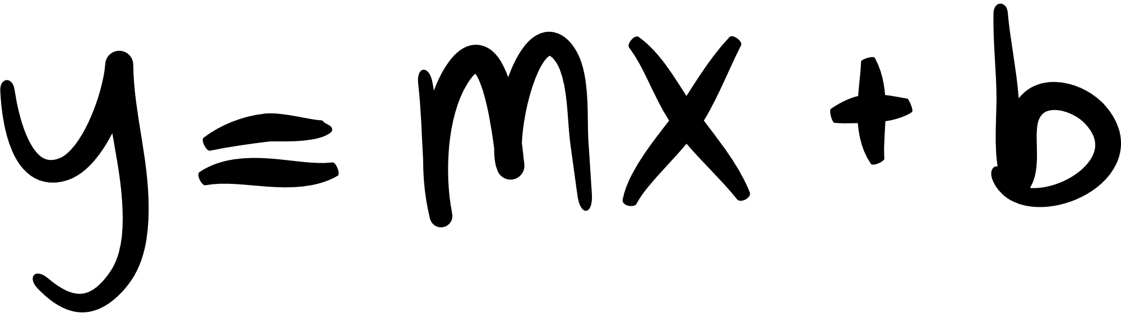
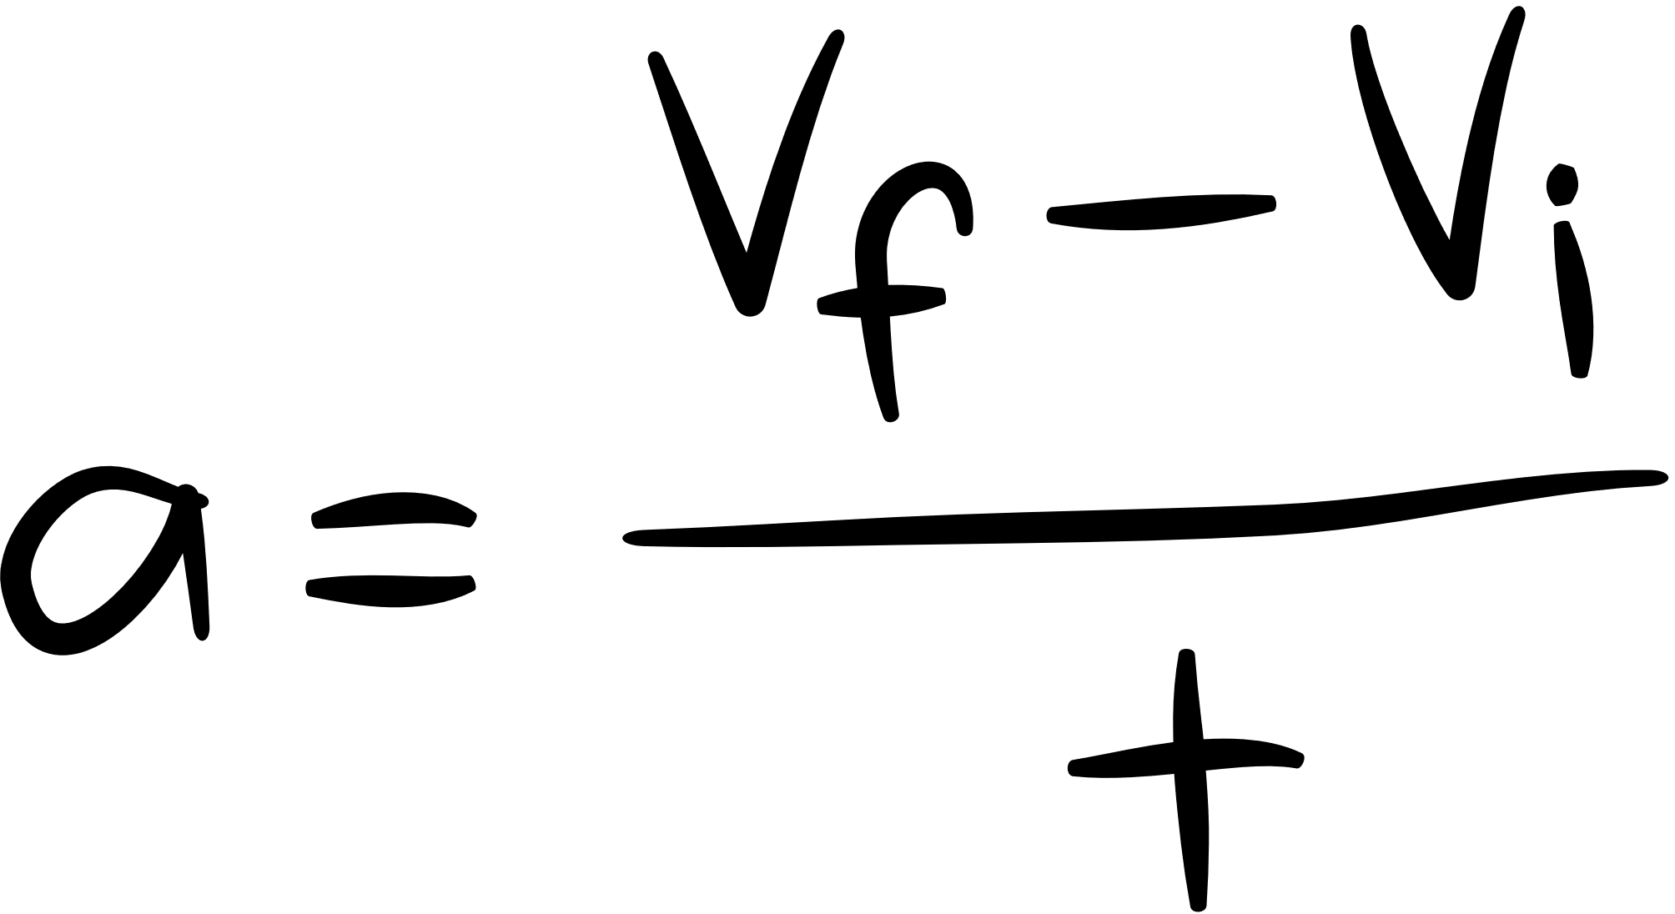
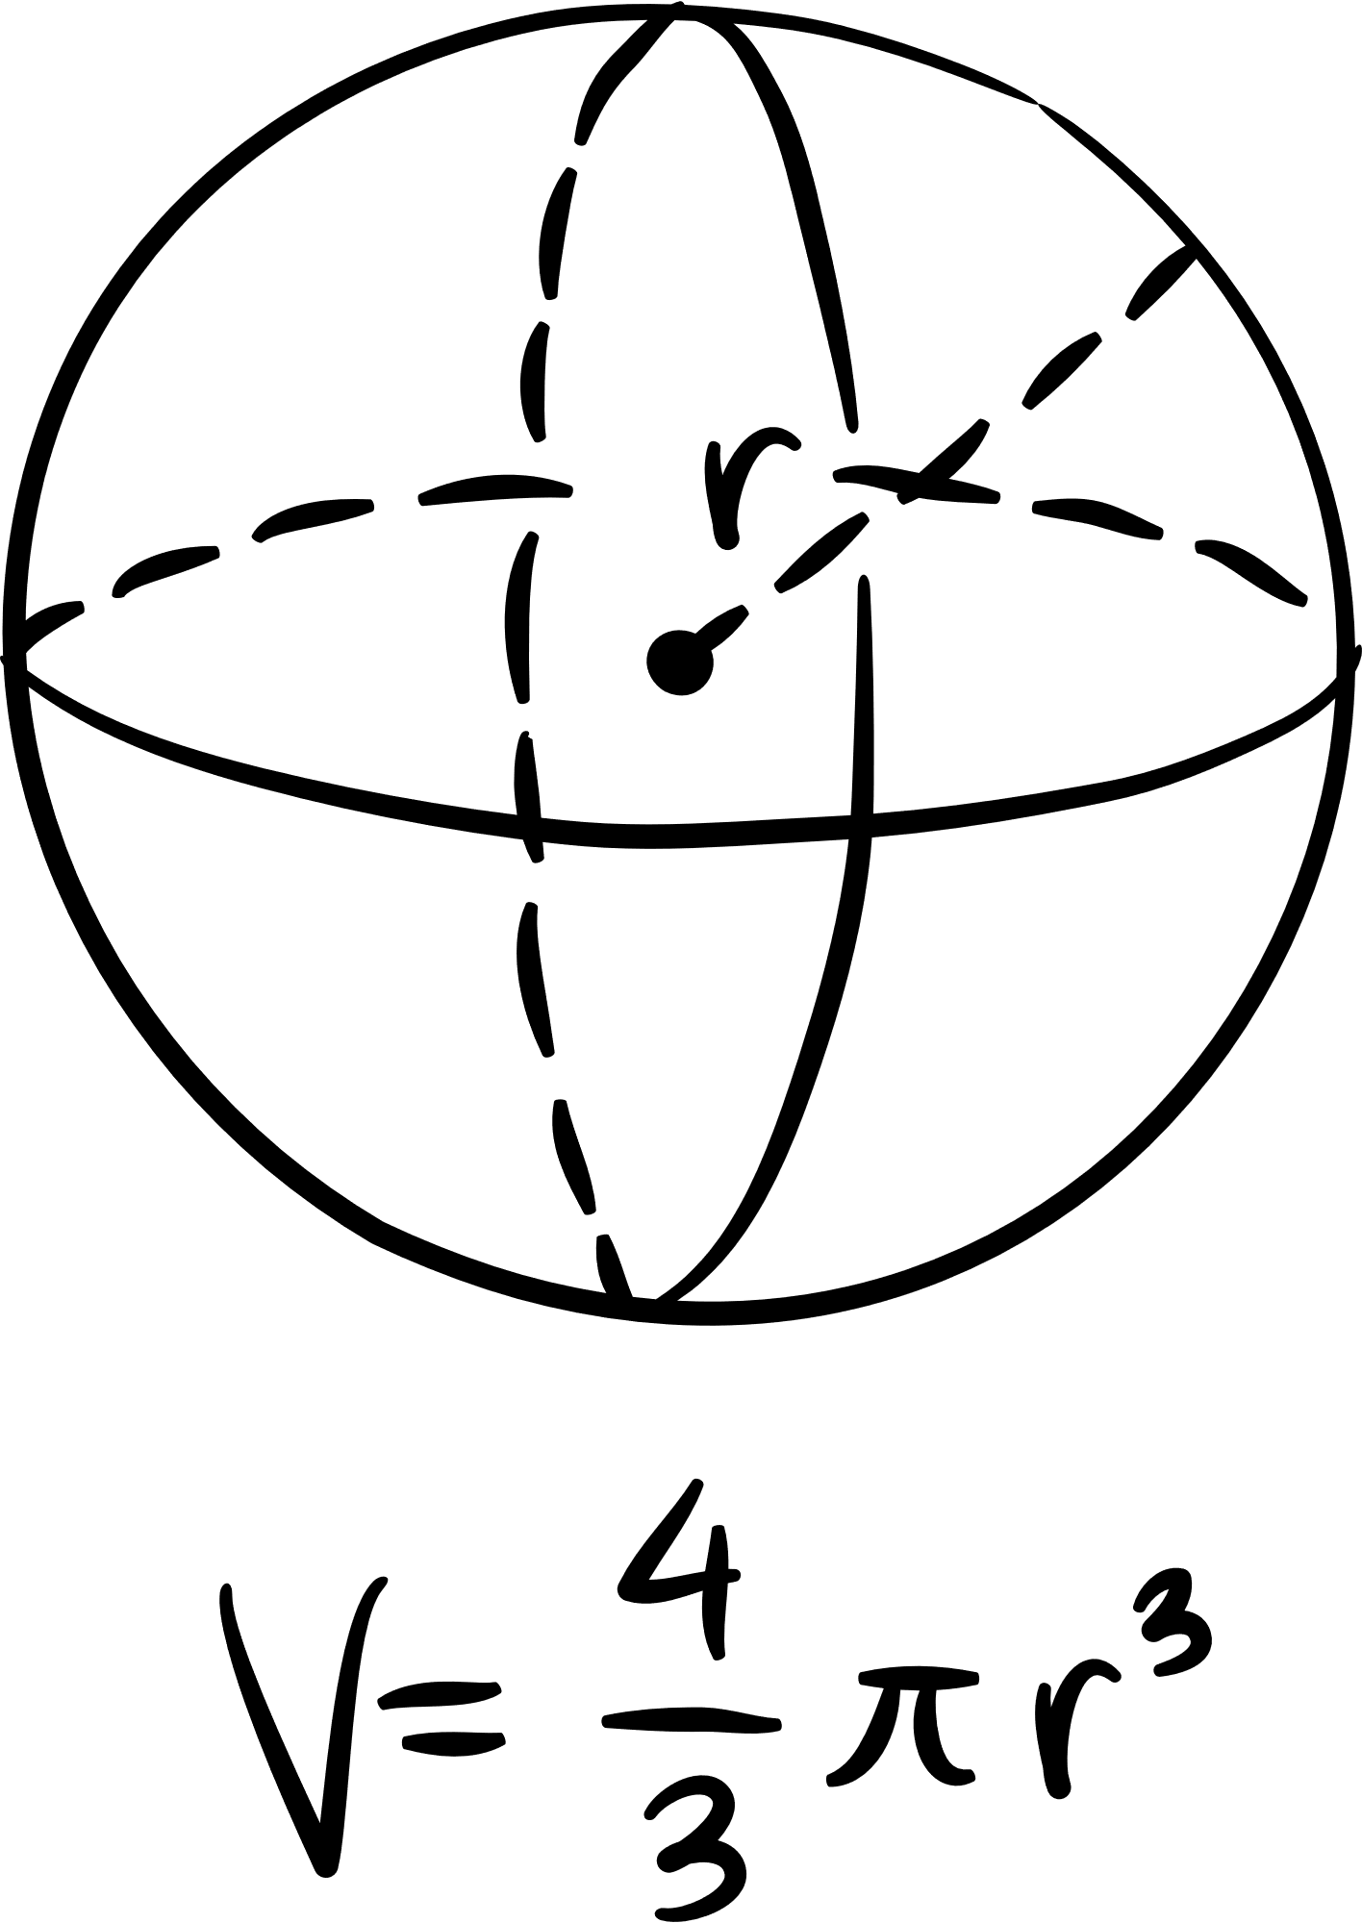
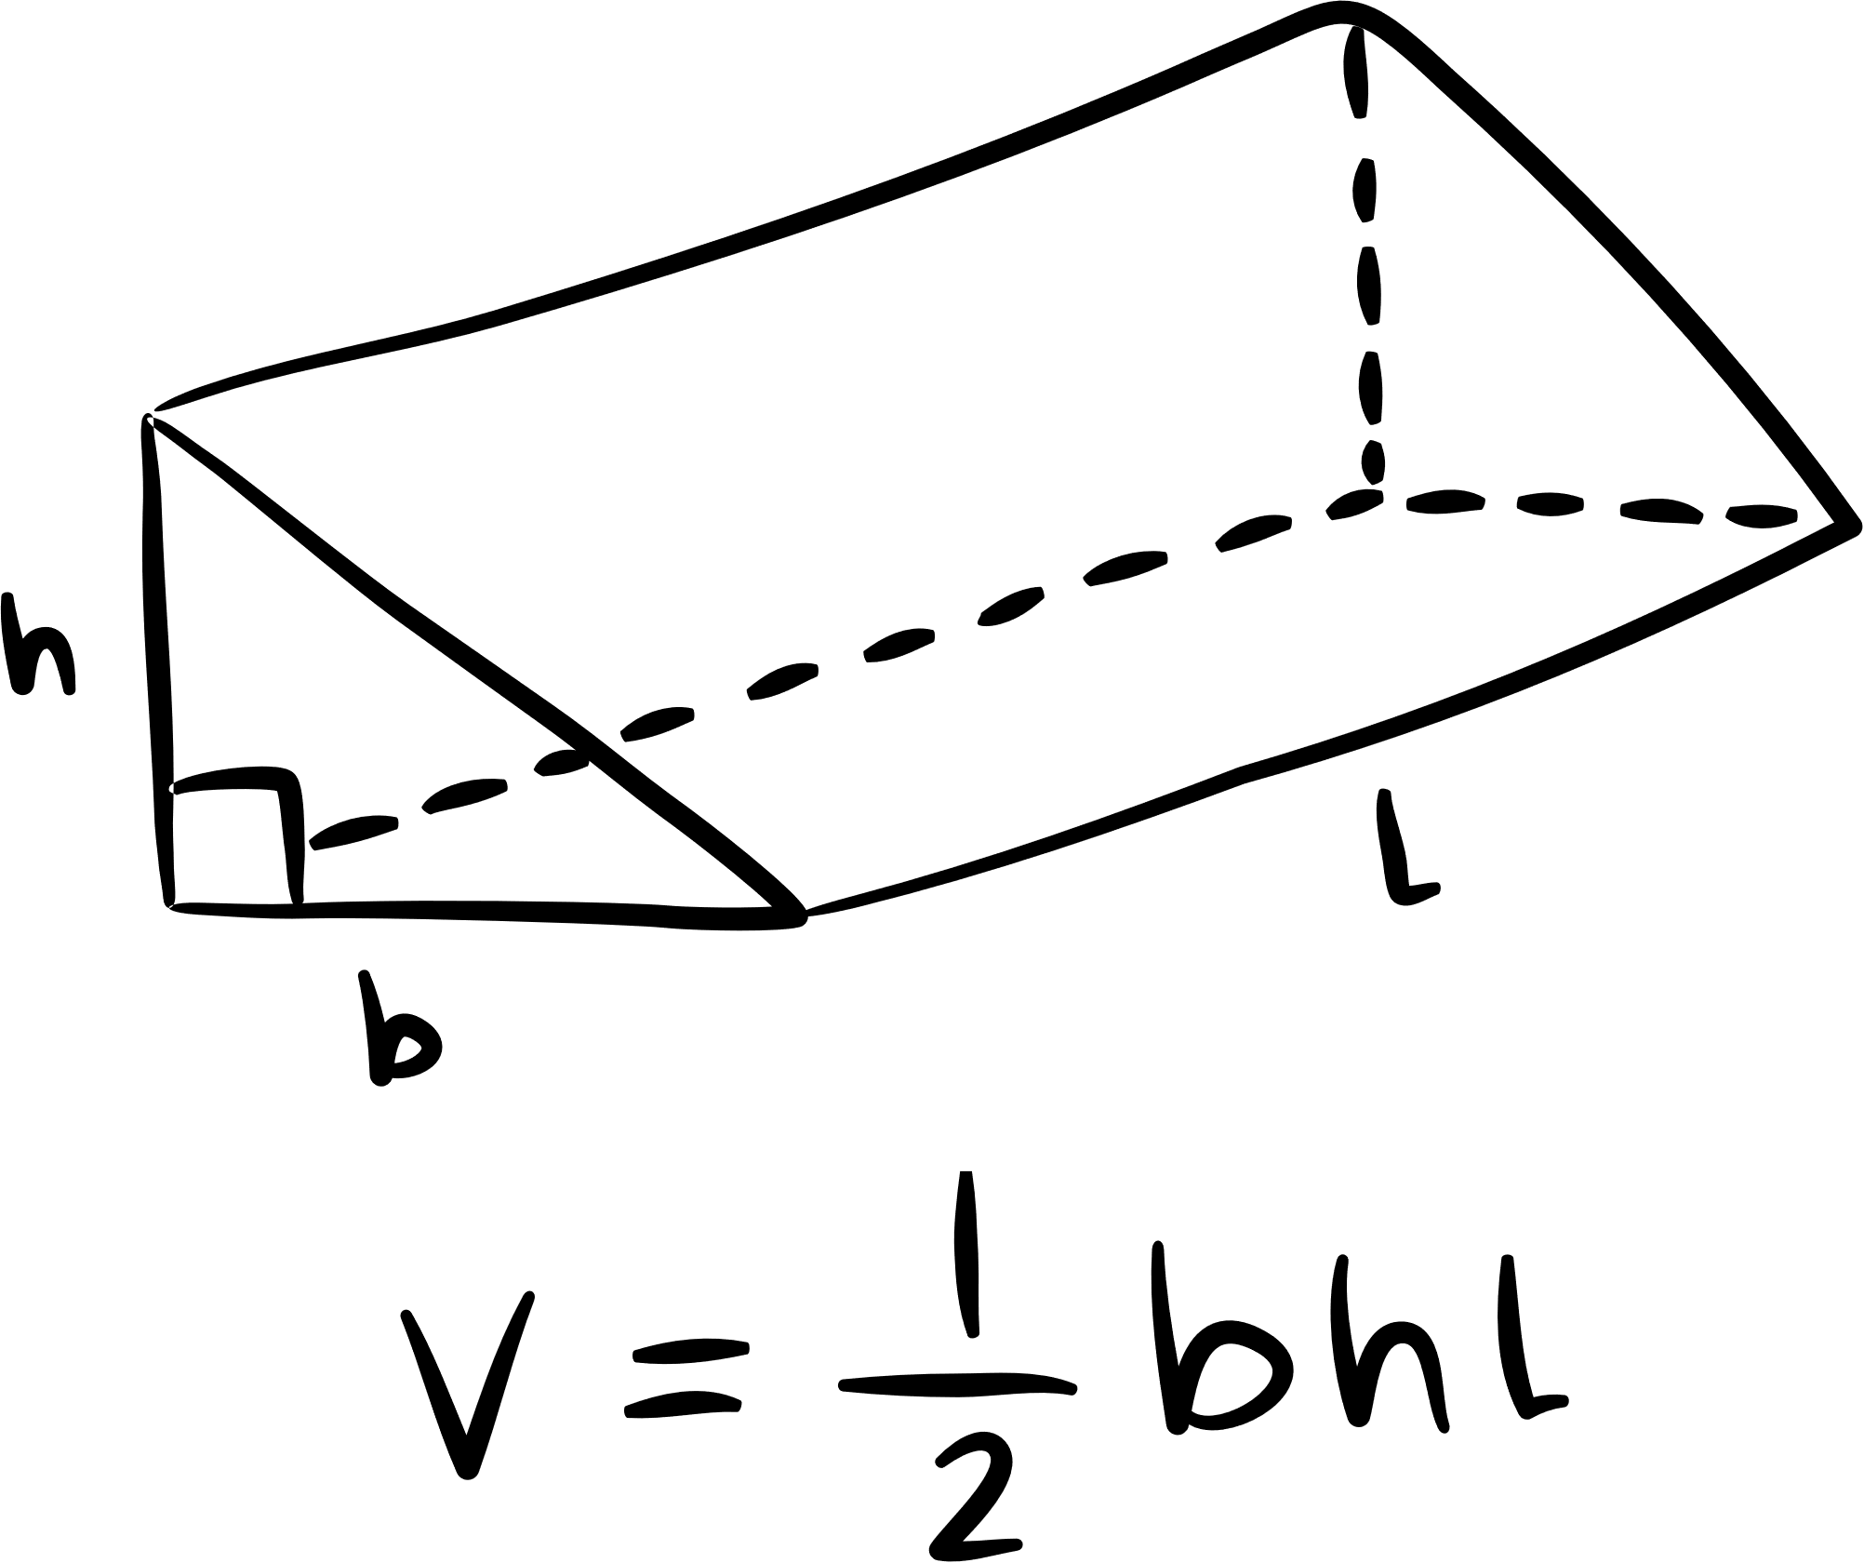
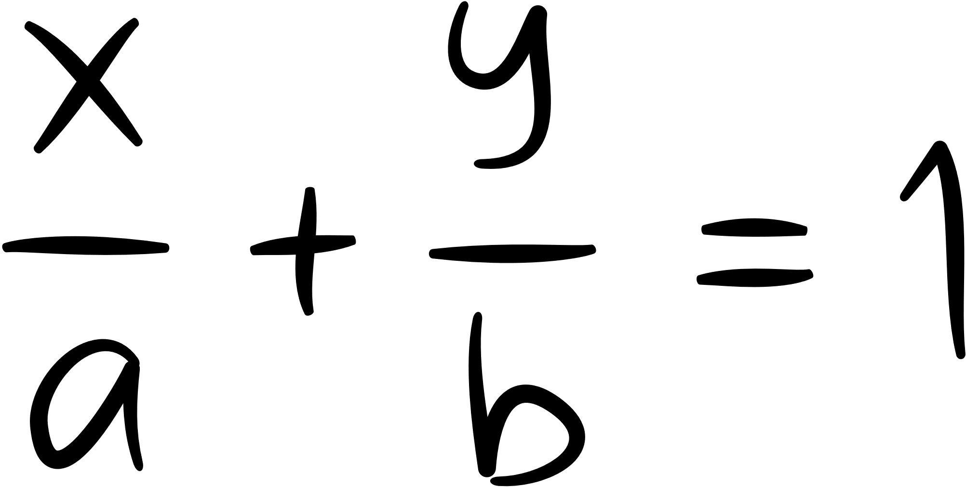
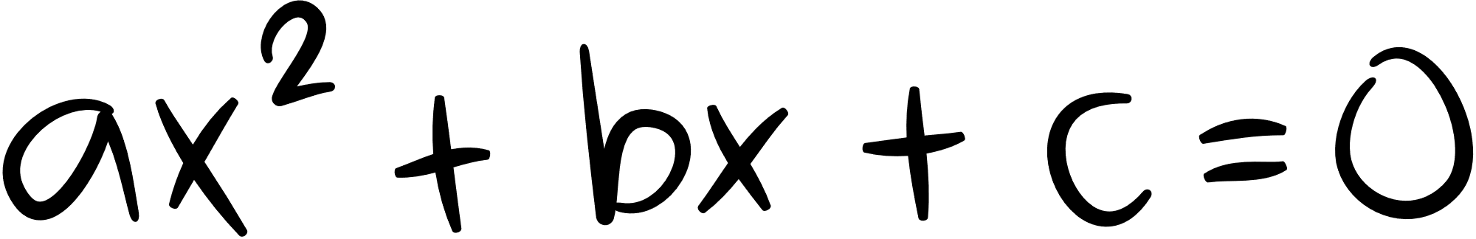
RANDOM VARIABLES

Slide 2
WHAT IS A RANDOM VARIABLE?
A random variable is a concept in probability representing uncertain outcomes. It could be rolling a die or any event with unpredictable results. These variables have probability distributions, describing it

Slide 3
TYPES OF RANDOM VARIABLE
CONTINOUS RANDOM VARIABLE
DISCRETE RANDOM VARIABLES

Slide 4
DISCRETE RANDOM VARIABLE

Slide 5
1- Bernoulli Distribution
It is random experiment that can only have an outcome of either 1 or 0
It’s parameter:
P : the probability of success and determines
the shape of the distribution

Slide 6
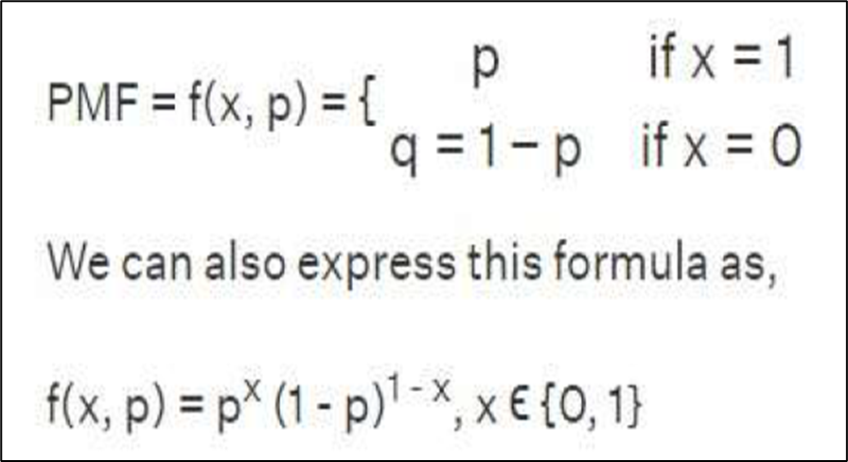
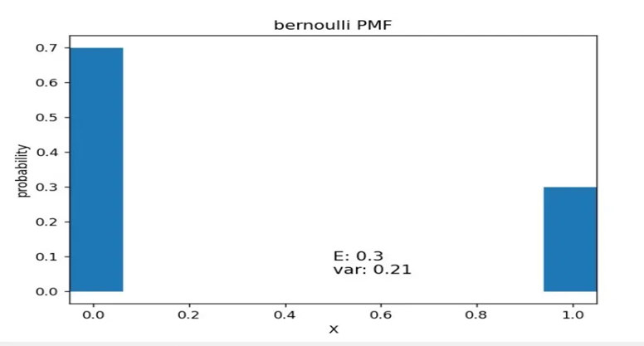
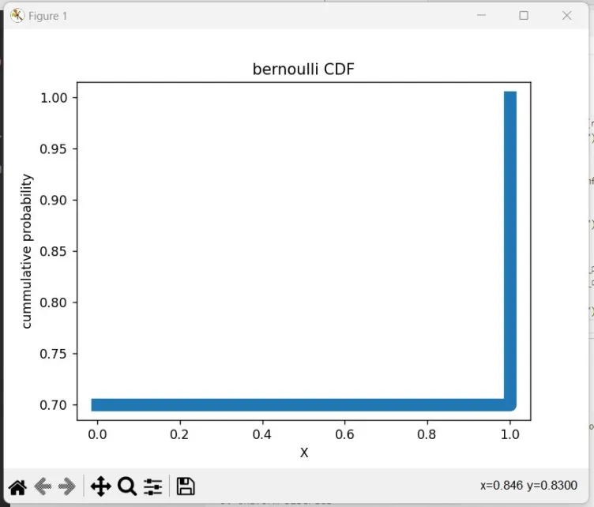
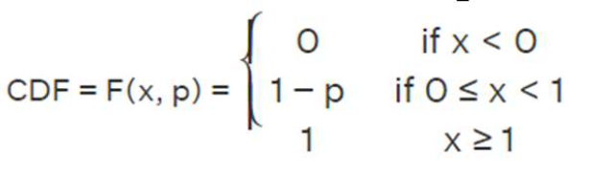
It’s probability mass function(PMF):
It’s cumulative distribution function(CDF):

Slide 7
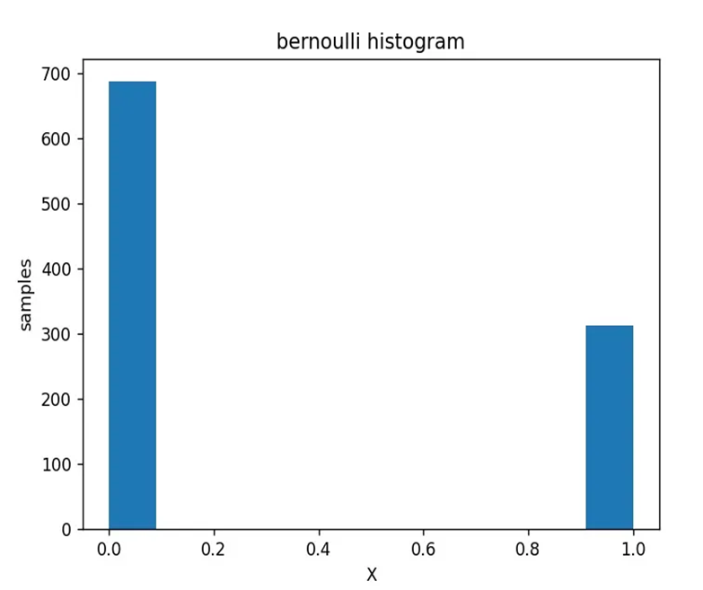
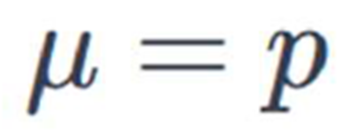
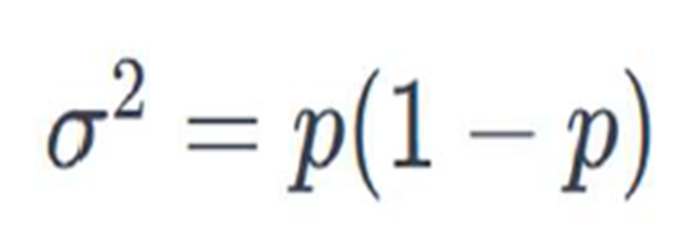
It’s Histogram:
It’s Mean(Expected Value):
It’s Variance:

Slide 8

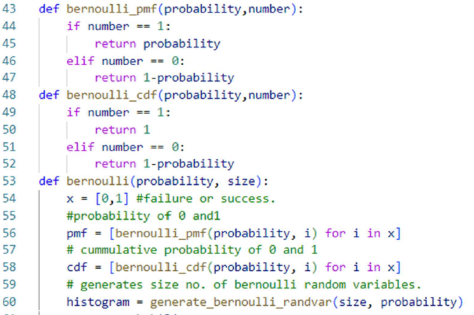

Slide 9
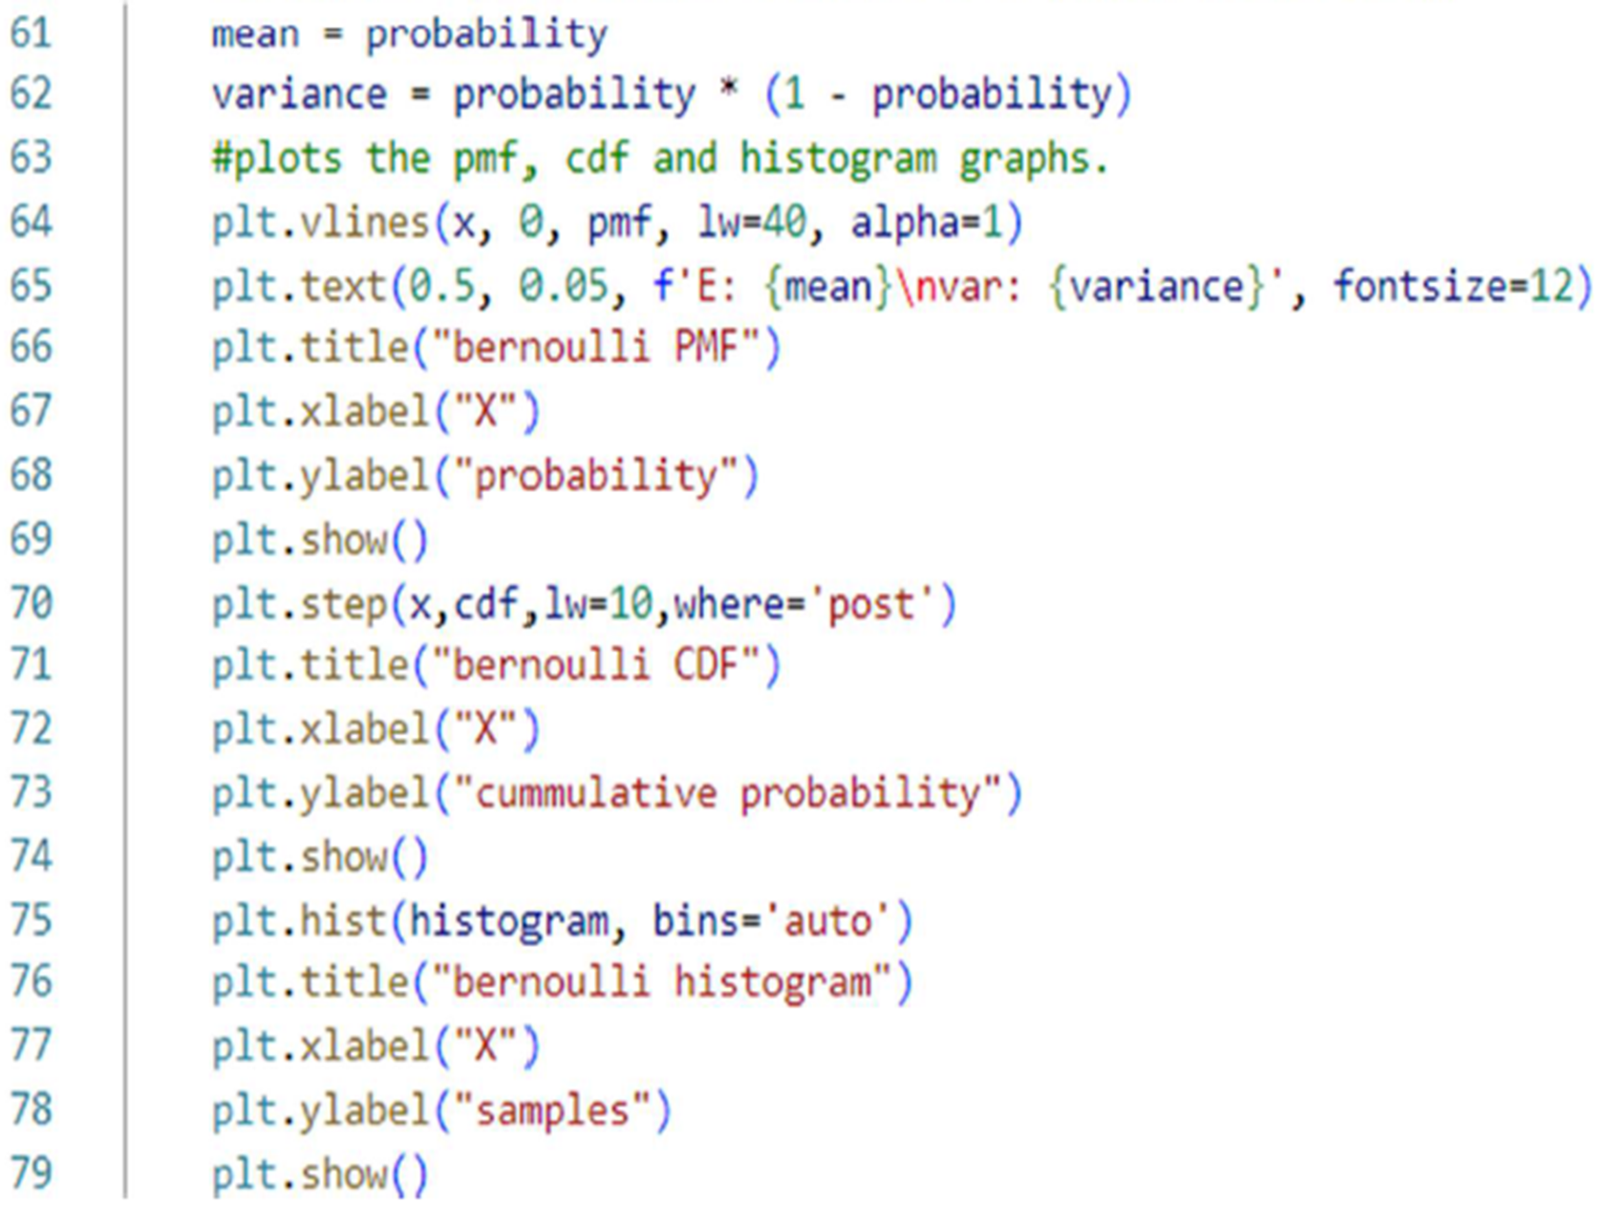

Slide 10
2-Benomial Distribution
Deals with the probability of having 'x' successes in 'n' trials , Binomial Def: deals with the probability of having 'x' successes in 'n' trials. In each trial, there are two outcomes (success or failure)
It’s Parameter :
P: is the probability of success
q: is the probability of failure
n: is the total number of trials.
k: is the number of successes

Slide 11
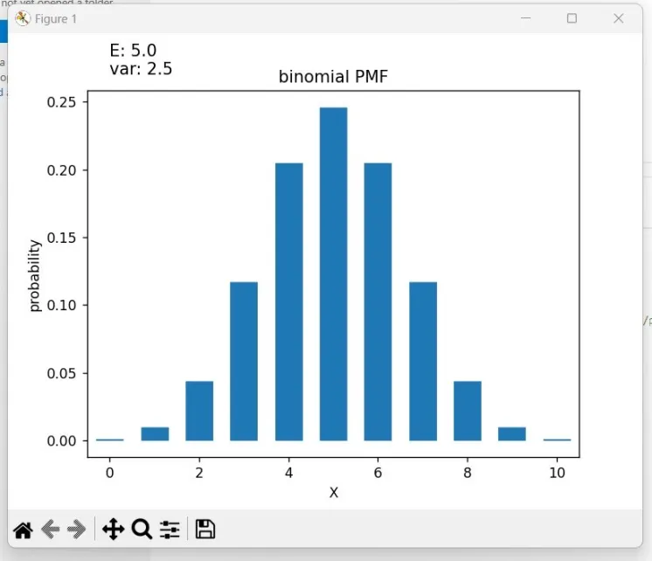
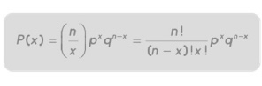
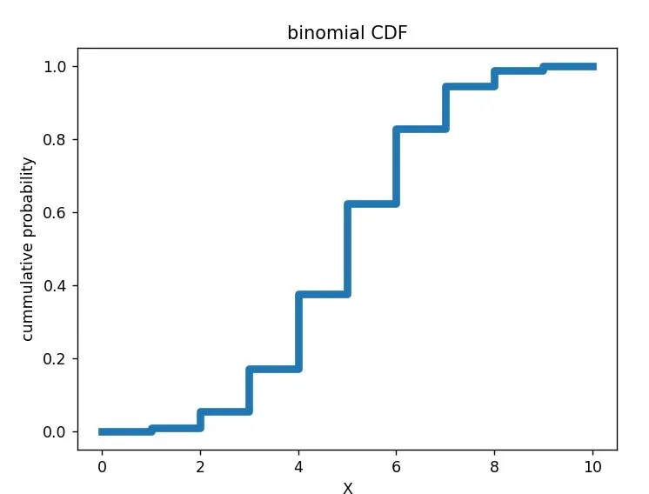
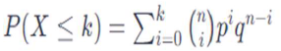
It’s Probability Mass Function(PMF):
It’s Cumulative Distribution Function(CDF):

Slide 12
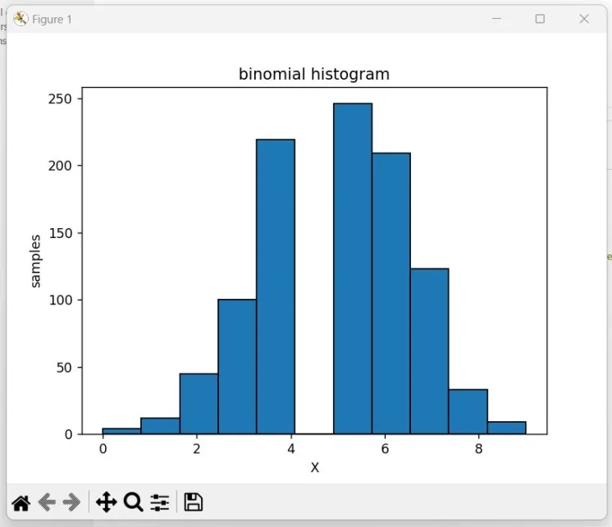

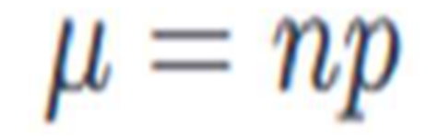
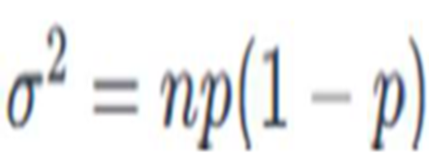
It’s Histogram:
It’s Variance:

Slide 13
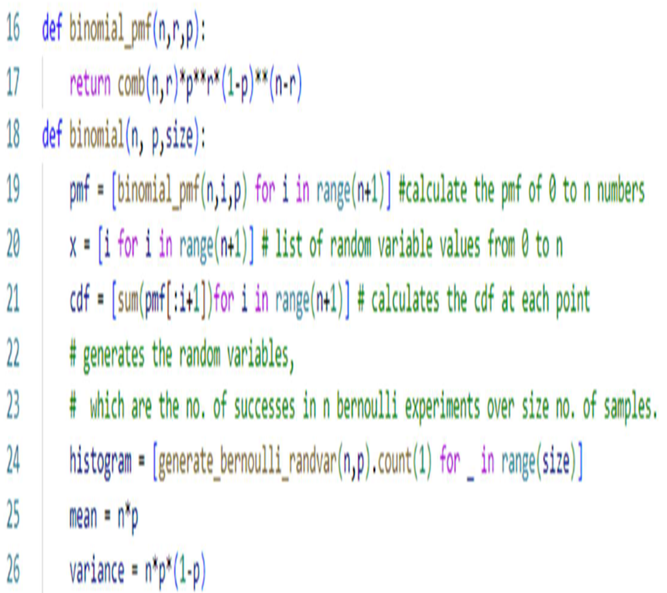

Slide 14
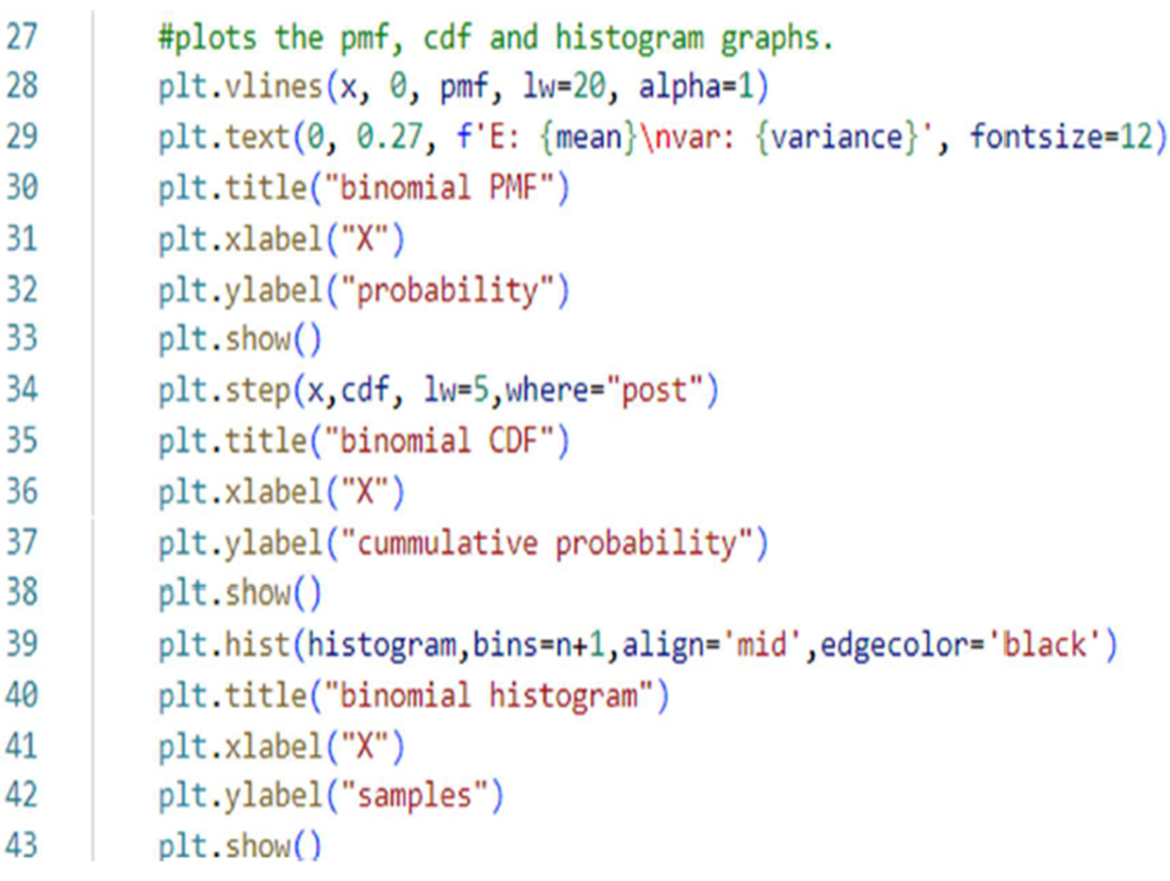

Slide 15
Real life example
we have a company having 1000 employees 100 of them are female if we want to calculate the probability of 10 of them developing breast cancer at some point in their life knowing that the probability of developing breast cancer in women is 1/8 Using the binomial formula : nCk*p^r*(1-p)^(n-r) where n is 100, r is 10 and p is 0.125 We get the probability: 0.097(9.7%).

Slide 16
3-Geometric Distribution
The number of trials needed to observe the first success each trial has two outcomes (success or failure)
It’s Parameter :
P: is the probability of success
X: number of trials

Slide 17
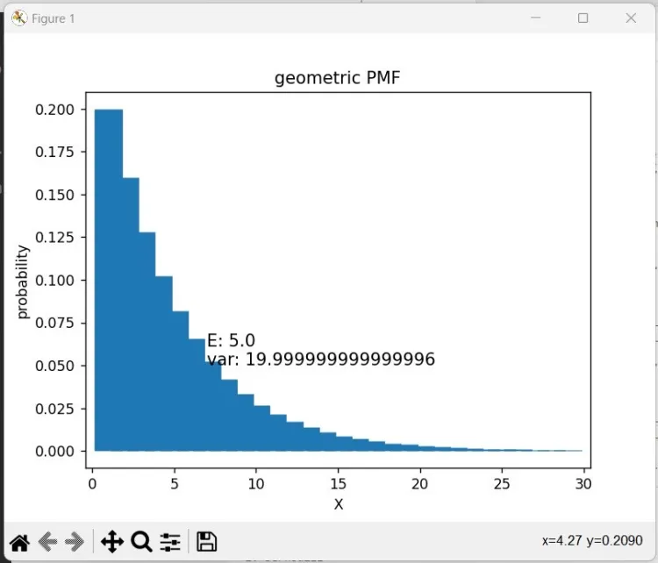
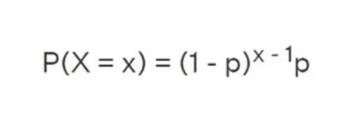
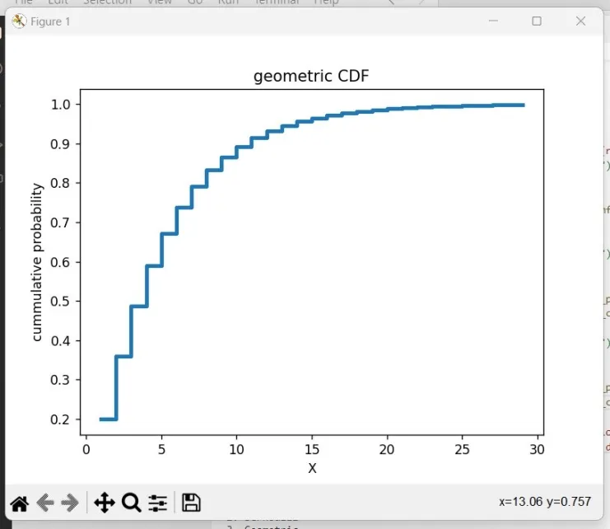
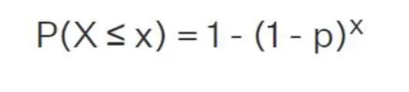
It’s Probability Mass Function(PMF):
It’s Cumulative Distribution Function(CDF):

Slide 18
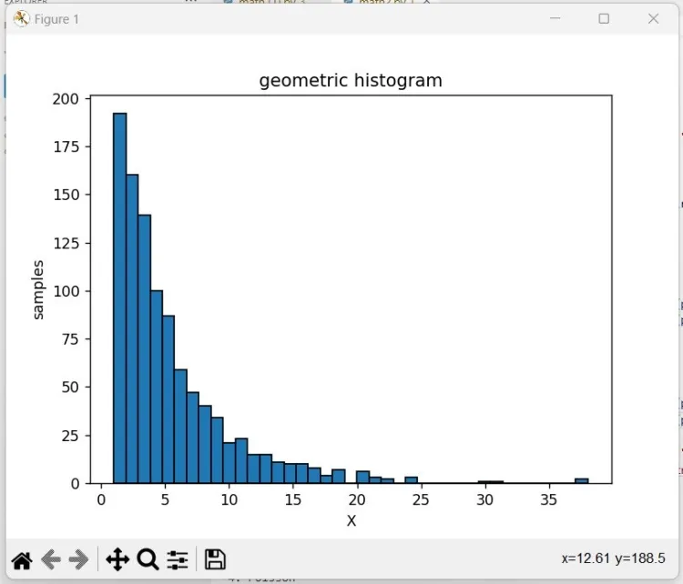
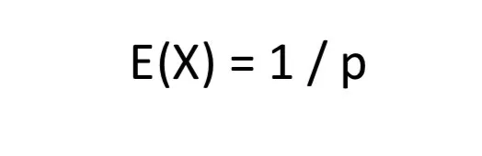

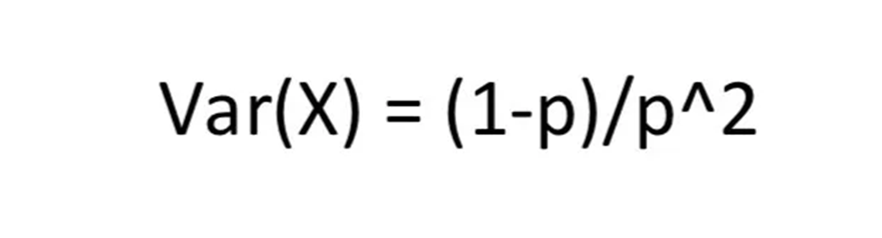

It’s Histogram:

Slide 19
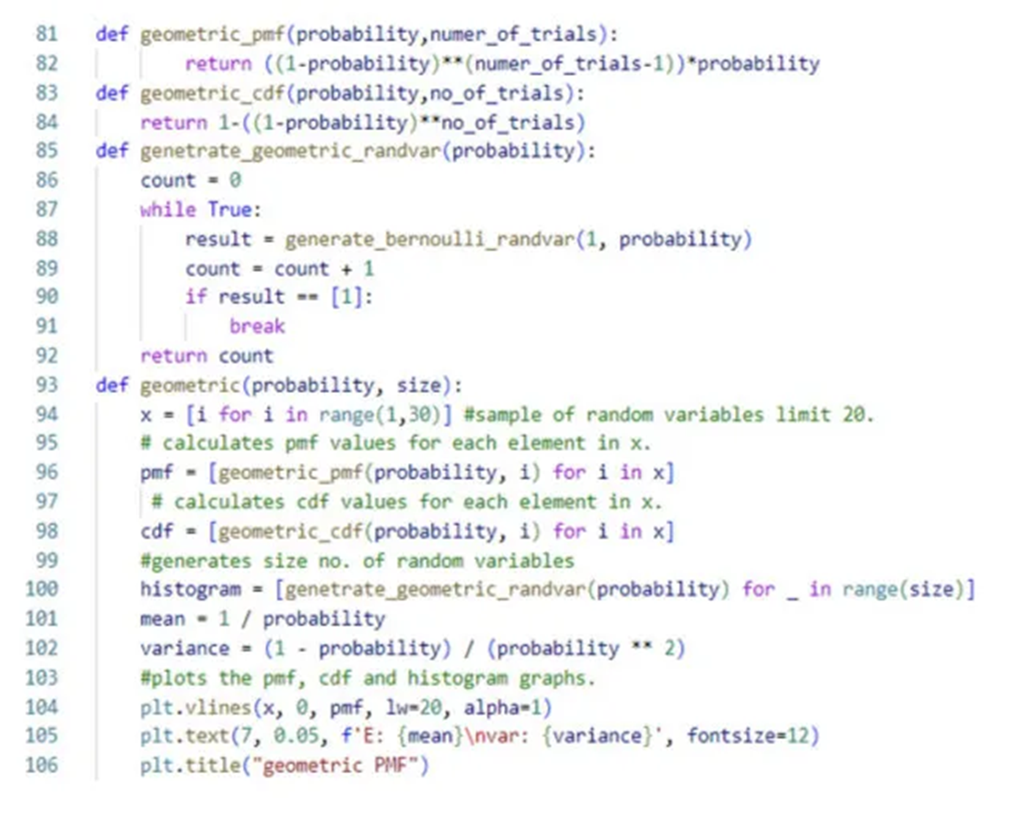

Slide 20
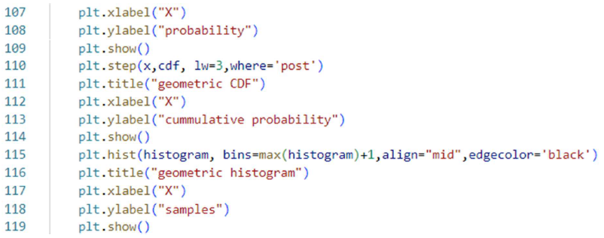

Slide 21
4-Poisson Distribution
It’s number of events that occur within a fixed interval of time with a known constant mean rate and independently of the time
It’s Parameter :
P: is the probability of success
X: number of trials

Slide 22
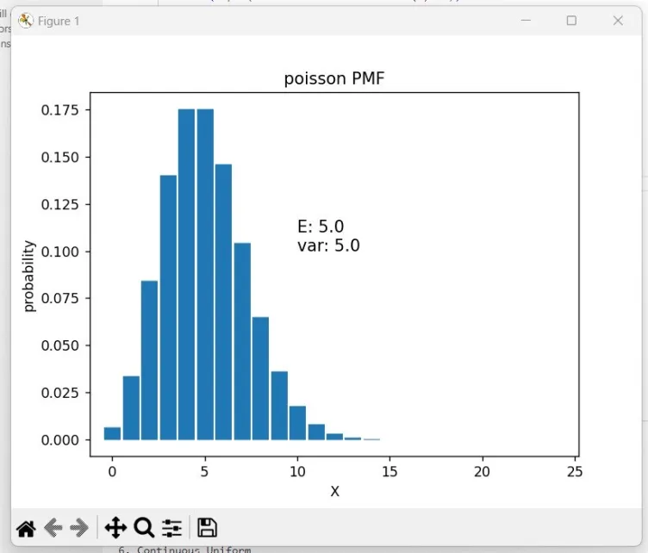
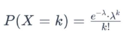
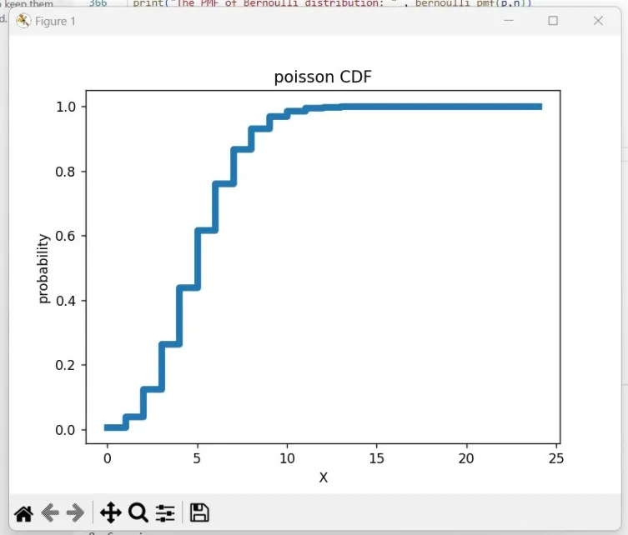
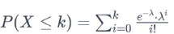
It’s Probability Mass Function(PMF):
It’s Cumulative Distribution Function(CDF):

Slide 23
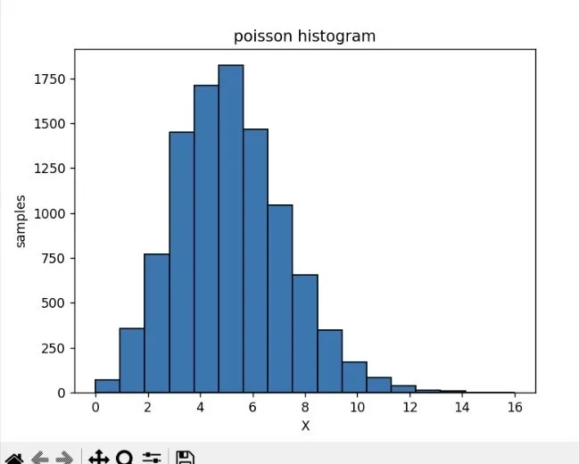
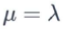


It’s Histogram:

Slide 24
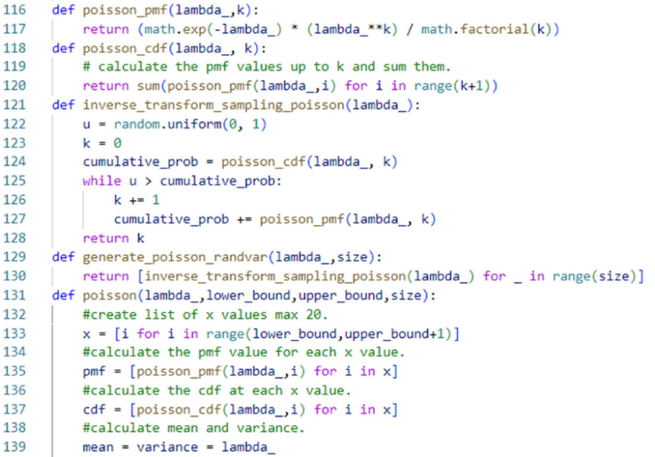

Slide 25
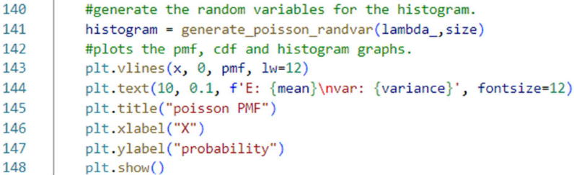
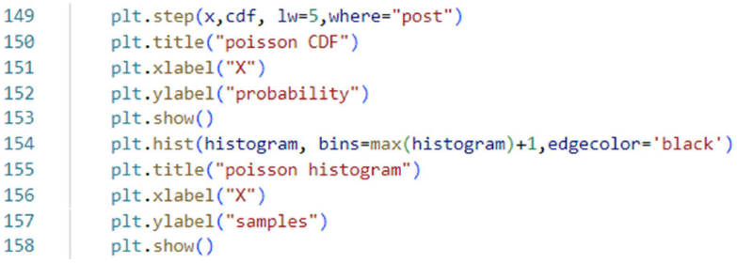

Slide 26
Real life example
Lets say that the average number of defect in a fabric roll = 6 (lambda) Let’s say a manufacturer wants to calculate the probability of finding 10 defects in two rolls Then the new lambda equals 2*6 = 12 defects Then according to the PMF formula of poission random variable : lambda^k*e^-lambda / k! The probability of finding 10 defects = 12^10 * e^-12 / 10! = 0.105 (10.5%)

Slide 27
5- Uniform Distribution
A type whose outcomes are equally likely over a finite set of values each possible outcome has the same probability of occurring
It’s Parameter :
(a) Lower Bound
(b) Upper Bound

Slide 28
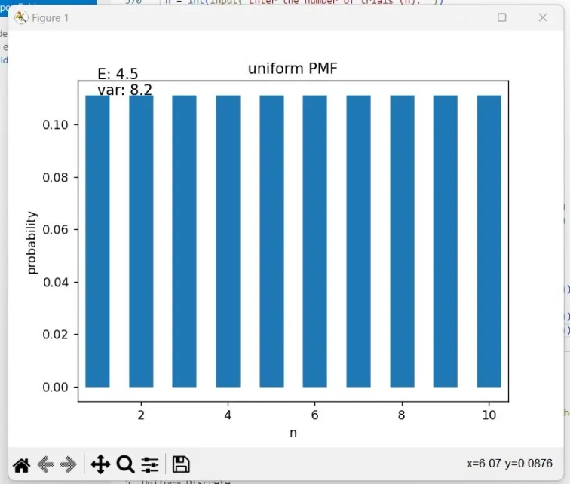
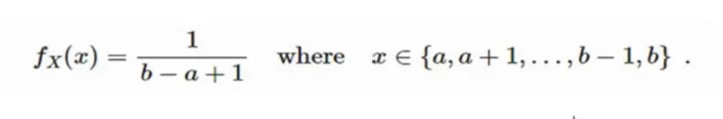
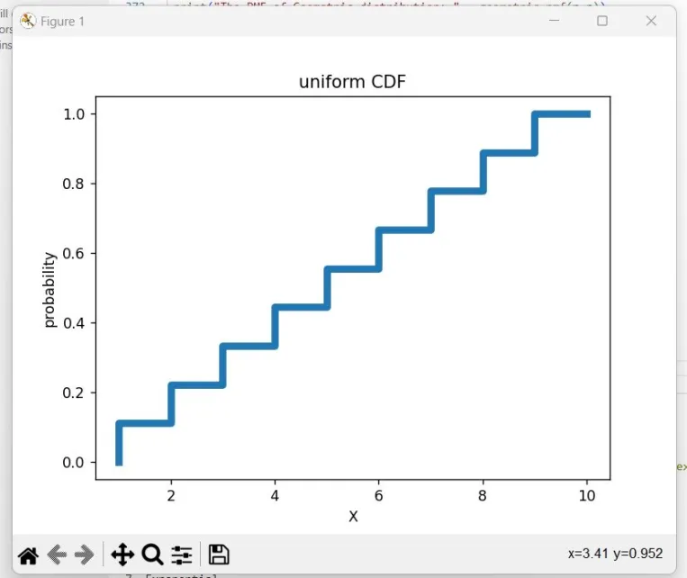
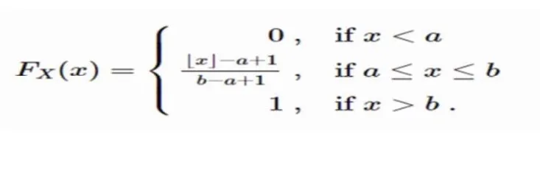
It’s Probability Mass Function(PMF):
It’s Cumulative Distribution Function(CDF):

Slide 29



It’s Histogram:

Slide 30


Slide 31


Slide 32
CONTINOUS RANDOM VARIABLE

Slide 33
1- Uniform Distribution
A type of symmetric probability distribution that describes an experiment in which the outcomes of the random variable have equally likely probabilities of occurring within an interval [a, b].
It’s Parameter :
(a) Lower Bound
(b) Upper Bound

Slide 34




It’s Probability Density Function(PDF):
It’s Cumulative Distribution Function(CDF):

Slide 35



It’s Histogram:

Slide 36



Slide 38
2- Exponential Distribution
A type of probability distribution that models the time until an event occurs in a (Poisson process)
It’s Parameter :
x: is the random variable representing the time between events
λ : is the rate parameter, indicating the average number of events per unit time

Slide 39




It’s Probability Density Function(PDF):
It’s Cumulative Distribution Function(CDF):

Slide 40



It’s Histogram:

Slide 41


Slide 42
Real life example
Lets say the Sum of time between departures = 996 mins The total number of flights = 92 Mean = 996/92 = 10.8 mins Lambda = 1/mean = 0.09 flights/mins What’s the Probability of delay between departures being more than 5 mins: p(x>5) = 1-P(x<=5) P(x<=5) = 0.095 p(x>5) = 1-0.095 = 0.90

Slide 43
3- Gaussian Distribution
Sometimes referred to as the normal distribution, is the most important continuous probability distribution in statistics and probability theory
It’s Parameter :
(µ, σ2)
These two parameters are exactly the first moment and the second central moment of the random variable

Slide 44




It’s Probability Density Function(PDF):
It’s Cumulative Distribution Function(CDF):

Slide 45



It’s Histogram:

Slide 46


Slide 47
Real life example
Lets say we have research about 212 players retirement The mean is 35 and standard deviation is 3.5 If we want to calculate the probability of a player retiring after the age of 38 So the p(x>38) = 1-P(x<=38) The cdf formula is 0.5 * (1 + erf((x- mean) / std_dev * sqrt(2)) So the P(x=38) = 0.78 So p(x>38) = 1-0.78 = 0.22 (22%)

Slide 48


Slide 49




Slide 50
Prepared by:
Abdelrahman Salah El-dein Abdelaziz
Abdullah Mohamed Mohamed Galal
Farida Waheed Abd El Bary
Mohamed Ahmed Mohamed Hassan
Nour Hesham El Sayed
Omar Sami Mohamed Ahmed
Razan Ahmed Fawzy

Slide 51
THANK YOU

